Slide 1
CS 2212
Introduction to Software Engineering
Chapter 10 Architectural Design

Slide 2
Copyright Notice This Presentation and Its Associated Video Contain Copyright Material. This Presentation and Its Associated Video Are Provided for Teaching Purposes of CS2212 and Should Not Be Posted In Any External Site, Or Shared with. This Presentation and Its Associated Video Are Provided For Instructional Personal Use Only, and Only For The Purposes of the CS2212 Course.

Slide 3
Part 26
Software Architecture – Definitions
The purpose of computing is insight, not numbers.
― Richard Hamming.
Notes:
This lesson introduces the basic steps in a software engineering project at a high level.
In practice, steps often overlap.

Slide 4
Learning Objectives in this Part
To understand the concept of software architecture and architectural views

Slide 5
Software Architecture
Software Architecture pertains to the specification of the overall structure of the system. This structure entails the system’s components, the basic characteristics of these components, and the interaction between components.
As we have already discussed software architecture provides a way to analyze and specify the system at a higher level of abstraction.
Software architecture specifications focus on the fundamental design decisions we take for a system

Slide 6
Definition by Shaw and Garlan
Abstractly, software architecture involves the description of elements from which systems are built, interactions among those elements, patterns that guide their composition, and constraints on these patterns. In general, a particular system is defined in terms of a collection of components and interactions among these components. Such a system may in turn be used as a (composite) element in a larger system design. [Garlan&Shaw]

Slide 7
Definition by Buschmann et al.
A software architecture is a description of the subsystems and components of a software system and the relationships between them. Subsystems and components are typically specified in different views to show the relevant functional and non-functional properties of a software system. The software architecture of a system is an artifact. It is the result of the software development activity. [POSA]
See http://www.sei.cmu.edu/architecture/definitions.html for 60+ other definitions…

Slide 8
Importance of Architecture
Software architecture provides a representation that facilitates communication among all stakeholders.
The architecture highlights early design decisions that will have a profound impact on all software engineering work that follows.
The architecture constitutes a relatively small model of how the system components are structured and work together.

Slide 9
Issues Addressed by an Architectural Design
Gross decomposition of a system into interacting components
Typically hierarchical
Using rich abstractions for “glue”
Often using common design idioms/styles
Emergent system properties
Performance, throughput, latencies
Reliability, security, fault tolerance, evolvability
Rationale
Relates requirements and implementations
Envelope of allowed change
“Load-bearing walls”
Design idioms and styles

Slide 10
Good Properties of an Architecture
Good architecture (like much good design):
Result of a consistent set of principles and techniques, applied consistently through all phases of a project
Resilient in the face of (inevitable) changes
Source of guidance throughout the product lifetime
Reuse of established engineering knowledge

Slide 11
Agility and Architecture
Using a technique called storyboarding, the architect contributes architectural user stories to the project and works with the product owner to prioritize the architectural stories with the business user stories as “sprints” (work units) are planned.
The architect works with the team during the sprint to ensure that the evolving software continues to show high architectural quality as defined by the nonfunctional product requirements.
Agile teams usually have the freedom to make system changes as new requirements emerge. Architects want to make sure that the important parts of the architecture were carefully considered and that developers have consulted the appropriate stakeholders.
Both concerns may be satisfied by making use of a practice called progressive sign-off in which the evolving product is documented and approved as each successive release is completed.

Slide 12
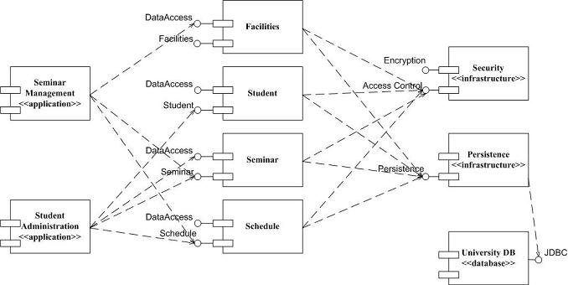
Example Architecture Specification (Component Diagram)
Client component on the
Security component
Server component for the
Facilities component
(among others)
Component
Connector
Service interface offered by
Component Schedule

Slide 13
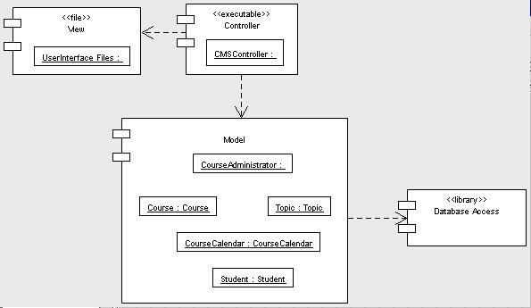
Example Architecture Specification (Component Diagram)
Dependency link: Denotes that the
Model component is a client to the
Database Access component

Slide 14
The Need For Multiple Design Views
Design is about system structure
How the system is decomposed into parts
Components and interactions with appropriate properties, enabling appropriate analyses
But this begs the question: what kinds of structure?
Many possibilities:
Code structure
Run-time structure
Process structure
Work breakdown structure
Each of these can be the basis of a Design View (or Architectural View)

Slide 15
Kruchten’s “4+1 View Model” of the Architecture
P. Kruchten. The 4+1 View Model of Architecture. In IEEE Software, vol. 12, no. 6, November 1995, pp. 42-50, © IEEE 1995

Slide 16
Refinement
Stepwise refinement is a top-down design strategy originally proposed by Niklaus Wirth
An application is developed by successively refining levels of procedural detail
A hierarchy is developed by decomposing a macroscopic statement of a function (a procedural abstraction) in a stepwise fashion until programming language statements are reached
As such, refinement is a process of elaboration, successively adding more and more detail as it is applied

Slide 17
Refactoring
Refactoring is a reorganization technique that simplifies the design (or code) of a component without changing its function or behavior
Martin Fowler defines refactoring in the following manner:
“Refactoring is the process of changing a software system in such a way that it does not alter the external behavior of the code [design] yet improves its internal structure.”
Refactoring can be an important design activity for many agile methods to ensure a sound design despite frequent additions, modifications, and evolutions

Slide 18
Part 27
Software Architecture Style – Definitions
One of my most productive days was throwing away 1000 lines of code.
― Ken Thompson.
Notes:
This lesson introduces the basic steps in a software engineering project at a high level.
In practice, steps often overlap.

Slide 19
Learning Objectives in this Part
To learn about the concept of architectural styles

Slide 20
Architectural Style
A system’s architecture is composed of
Components: package and implement the system’s functions
Connectors: implement the interconnections between the Components
An architectural style defines a family of architectures which have:
Common topologies (how components are interconnected)
Semantic constraints
Common vocabulary for their components and their connectors

Slide 21
Good Properties of an Architecture
Good architecture (like much good design):
Result of a consistent set of principles and techniques, applied consistently through all phases of a project
Resilient in the face of (inevitable) changes
Source of guidance throughout the product lifetime
Reuse of established engineering knowledge

Slide 22
Catalogues of Architectural Styles and Patterns
Architectural styles
[Garlan&Shaw] M. Shaw and D. Garlan. Software Architecture: Perspectives on a Emerging Discipline. Prentice Hall, Englewood Cliffs, NJ, 1996
Architectural Patterns
[POSA] F. Buschmann, R. Meunier, H. Rohnert, P. Sommerlad, and M. Stal. Pattern-Oriented Software Architecture. A System of Patterns. John Wiley & Sons Ltd., Chichester, UK, 1996

Slide 23
Overview of Styles
Architectural styles
Data Flow
Batch Sequential
Pipes and Filters
Call-and-return
Main Program / Subroutine
Data Abstraction
Object Oriented
Interacting processes
Implicit Invocation
MVC
Data-oriented repository
Transactional Data Bases
Blackboard
Hierarchical
Layered
Tiered
Heterogeneous architectures

Slide 24
“Pure” Form of Styles
When we define a software architecture style we usually present its simple form
In practice, we rarely use a software architecture style in its simple form. What we do is we combine appropriate architectural styles to design a new system.
As software architects we should have a good understanding of the different styles in their simple form, know the pros and cons of each style, and understand what is the impact of changes or modifications on an architecture style

Slide 25
Your Turn
What is the purpose of architectural views?
What is an architectural style?
What is the difference between a component element and a deployment element?
Check-out the content of the following sites:
https://en.wikipedia.org/wiki/4+1_architectural_view_model
https://en.wikipedia.org/wiki/Software_architectural_style
https://www.tutorialspoint.com/software_architecture_design/architecture_models.htm
https://herbertograca.com/2017/07/28/architectural-styles-vs-architectural-patterns-vs-design-patterns/
https://www.sciencedirect.com/science/article/pii/S187705091503183X (software architecture survey paper)

